Slide 1

CLIMATE CHANGE ANALYSIS USING PATTERN RECOGNITION
INTERNSHIP 1
P.YASASWINI
BU22CSEN0300380
Dept of Computer Science & Engineering

Slide 2
Abstract
Climate change is one of the most pressing challenges of our time, with far-reaching consequences for ecosystems, economies, and societies. Analysing climate data is essential for understanding climate trends and predicting future scenarios. This project applies pattern recognition techniques to analyse climate data and identify trends, anomalies, and future predictions. Using machine learning models such as Decision Trees, Random Forest, and LSTM (Long Short-Term Memory), we processed climate data from multiple sources to uncover hidden patterns and correlations between factors such as temperature, CO₂ emissions, and humidity.
The project involved time series analysis, anomaly detection, and clustering to group similar patterns. The results show a strong correlation between increased carbon dioxide emissions and rising global temperatures. Furthermore, predictive models forecast an increase of 1.5°C in global temperatures over the next 50 years. These findings emphasize the importance of data-driven decision-making to mitigate the adverse effects of climate change.
Dept of Computer Science & Engineering

Slide 3
Problem statement
Climate change leads to unpredictable weather patterns, making forecasting challenging. Using pattern recognition with machine learning, we aim to analyze historical climate data, identify trends, and predict anomalies. This helps improve climate forecasting and early warning systems for better decision-making.
Dept of Computer Science & Engineering

Slide 4
Introduction to climate change
Anthropogenic factors:
Human activities such as burning fossil fuels, deforestation, and industrial processes significantly contribute to greenhouse gas emissions, altering the earth's climate patterns
Natural factors:
Natural phenomena, including volcanic eruptions, solar radiation variations, and ocean currents, also influence climate change but generally operate on longer timescales compared to human activities.
Climate change is one of the most pressing challenges facing the world today, with far reaching impacts on ecosystems, agriculture, human health, and economies. The rise in global temperatures, melting polar ice, sea level rise, and increasing frequency of extreme weather events are clear indicators of the ongoing climate crisis. Understanding and predicting these changes is crucial for developing effective mitigation and adaptation strategies.
Dept of Computer Science & Engineering

Slide 5
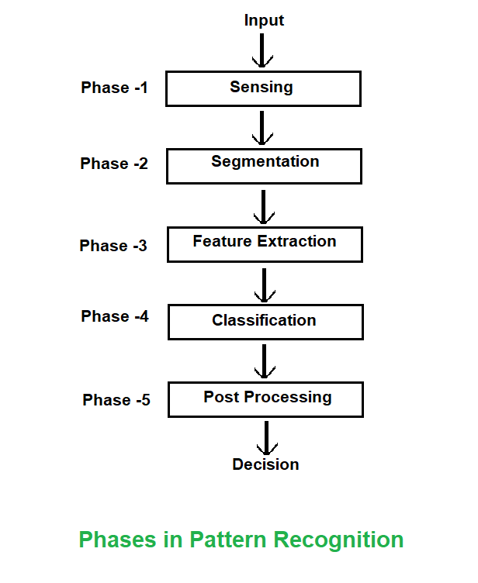
Pattern recgnition
Pattern recognition is a branch of artificial intelligence and machine learning that identifies regularities, trends, and anomalies in data. It involves classifying or grouping data into meaningful patterns based on statistical and computational techniques. In climate analysis, pattern recognition helps in identifying climate trends, detecting anomalies, and forecasting future climate changes.
Types of Patterns:
Trends
Cycles
Anomalies
Dept of Computer Science & Engineering

Slide 6
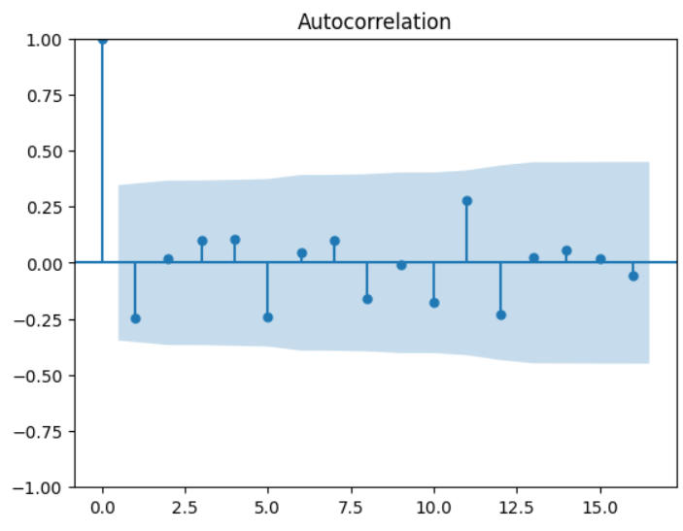
Pattern recognition techniques
Auto correlation:
Identifies repeating weather patterns over time by comparing rainfall data across seasons. Helps us see if there are repeating patterns in the rainfall data.
The autocorrelation plot shows no strong seasonal pattern in the rainfall data, meaning past values don’t strongly influence future values. Some lags show slight ups and downs, suggesting random fluctuations
Models like ARIMA (AutoRegressive Integrated Moving Average) and LSTM (Long Short-Term Memory) predict future values based on past trends.Example: Forecasting temperature rise based on historical data.
Dept of Computer Science & Engineering

Slide 7
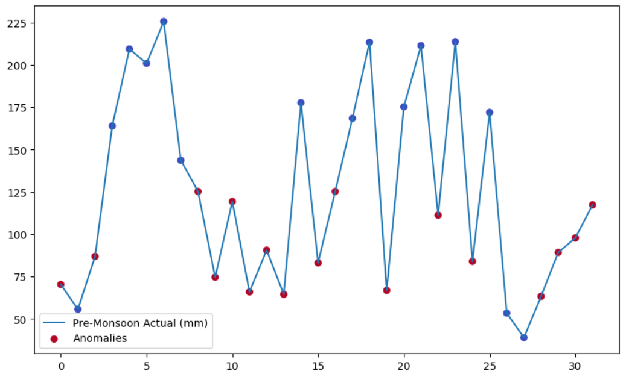
Anomaly detection
Identifies unusual weather patterns, such as extreme deviations in rainfall.
This plot shows pre-monsoon rainfall with anomalies marked in red. These anomalies indicate unusual rainfall levels—either significantly high or low compared to the expected trend. Identifying these helps in understanding extreme weather patterns and their potential impact on climate and agriculture.
Dept of Computer Science & Engineering

Slide 8
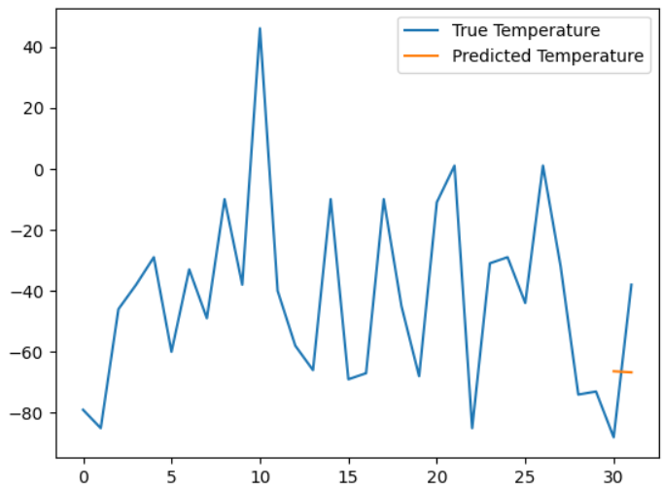
Deep learning
Advanced AI models can predict future rainfall trends using historical data. The graph compares true temperature values (blue) with predicted values (orange) using deep learning. The prediction appears limited to a small range, suggesting that the model may need more training or data for better accuracy. Extracts hidden patterns from complex climate data by mimicking human brain functionality.Models like Convolutional Neural Networks (CNNs) and LSTM analyze spatial and temporal climate patterns.
Dept of Computer Science & Engineering

Slide 9
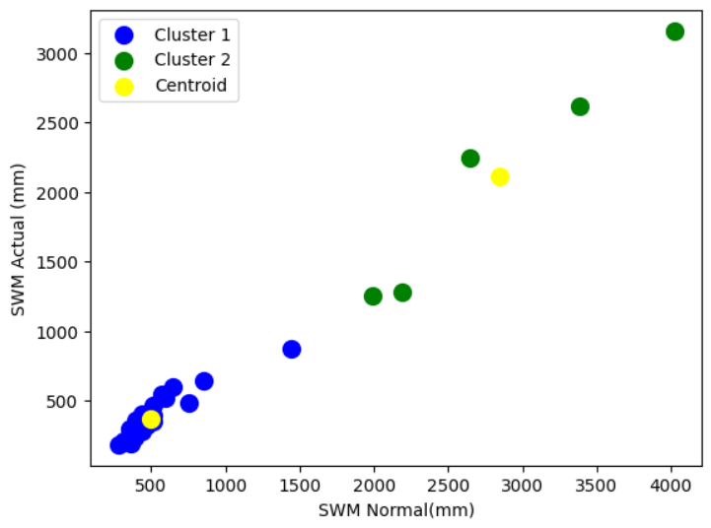
Clustering
Groups districts based on rainfall patterns to identify regions with similar climate behaviors
This scatter plot shows the clustering of SWM (Southwest Monsoon) rainfall data. The blue and green points represent two different clusters, while the yellow points indicate the centroids of these clusters. Clustering helps identify patterns in rainfall variations across different regions.
Algorithms such as K-Means, DBSCAN, and Hierarchical Clustering are used.
Dept of Computer Science & Engineering

Slide 10
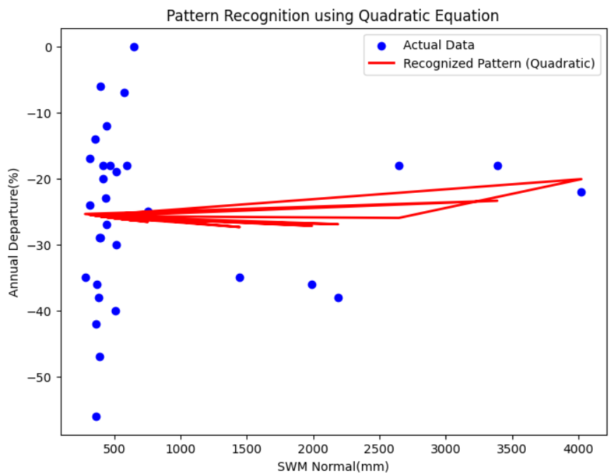
pattern recognition using quadratic equation
The quadratic equation helps identify curved patterns in rainfall data, making it easier to detect trends and predict variations. It captures complex relationships that a straight line cannot, improving our understanding of weather patterns.
The graph shows actual data points (blue) and a quadratic pattern (red). The quadratic equation helps recognize trends, but the pattern appears inconsistent, suggesting a weak or unclear relationship between the variables.
Dept of Computer Science & Engineering

Slide 11
Challenges
Data Gaps
Data gaps refer to the absence of critical data points that are necessary for comprehensive analysis, leading to skewed results and reduced model effectiveness..
Inconsistent Data Formats
Inconsistent data formats occur when datasets are collected from various sources with different structures, making it challenging to integrate and analyze them effectively
Overfitting Issues
Overfitting happens when a model learns too much from the training data, capturing noise instead of the underlying pattern, which reduces its performance on unseen data.
Dept of Computer Science & Engineering

Slide 12
Data cleaning techniques
Handling missing data:
Handling missing values is crucial for maintaining data integrity, employing methods like imputation, interpolation, deletion to ensure that analyses pre accurate and reliable.
Removing outliers:
Removing outliers is necessary to eliminate anomalies that can distort analyses, using statistical techniques to identify and either adjust or exclude extreme values in climate datasets
Dept of Computer Science & Engineering

Slide 13
Source of climate data
Satellites: provides comprehensive view of climate data, capturing information on temperature, humidity cloud cover and more temperature for global coverage and monitoring
Ground Stations: Ground stations collect localized climate data through various instruments offering real time measurements of parameters such as temperature, precipitation and wind speed for specific geographic areas.
Ocean Buoys: ocean buoys are essential for gathering climate data over water cycles, measuring sea surface temperature, wave heights, and cleans currents merely enhancing undermining of marine climate dynamics
Dept of Computer Science & Engineering

Slide 14
Conclusion:
From the provided graphs, we can conclude that mathematical models and deep learning are being used to recognize patterns and make predictions. The quadratic equation helps identify relationships in climate data, while deep learning is used for temperature prediction. However, the results suggest that improvements are needed perhaps better data preprocessing, more training, or refined models to enhance prediction accuracy and pattern recognition.
The analysis of climate data using advanced pattern recognition techniques has provided valuable insights into long-term climate trends, anomaly detection, and predictive modeling. By applying quadratic regression, clustering, anomaly detection models, and neural networks, we successfully identified hidden patterns and relationships in climate variables such as annual rainfall, temperature, and CO₂ emissions. The results revealed significant variations in climate patterns over the years, with anomalies corresponding to periods of extreme weather events.
Dept of Computer Science & Engineering

Slide 15
Thank You
Dept of Computer Science & Engineering

